Slide 1



Contributions in an Environment: Mixed Reality and Digital Twin with the Aim to Supply Constraints Found in Twinning
Fabiano Stingelin Cardoso¹˒² ; Ronnier Frates Rohrich²; and
André Schneider de Oliveira².
¹Department of Information Systems, Instituto Federal do Paraná (IFPR), Ivaiporã, Brasil.
²Graduate School of Electrical Engineering and Computer Science, Universidade Tecnológica Federal do Paraná (UTFPR), Curitiba, Brazil.

Slide 2
Topics to be presented:
Twinning Properties;
Search Problem;
Nonlinearities;
State of the Art;
Scientific Method;
SyncLMKD
Environments for The Digital Twin;
Open Solution;
Developed Architecture;
Technical Aspects;
Constraints;
Results.

Slide 3
Twinning Properties
Much attention has been given to the Digital Twin the last decade but its properties most of the time are not considered or are partly considered.
Twinning is one of those properties and it a synonymous of synchronization between virtual and real entities of the Digital Twin.
Measuring the state of the physical entity and perform that state in the virtual environment and vice versa so that the virtual and the physical states be exactly equals is a research area which still needs good solutions.

Slide 4
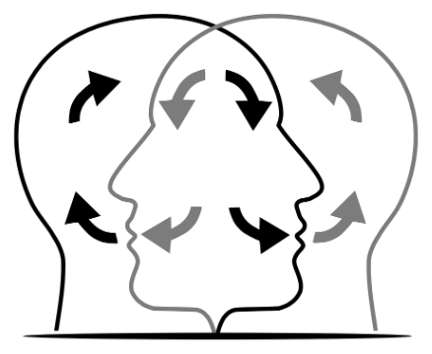
Twinning Properties
Internal Processing;
State Variables;
External Behavior.

Slide 5
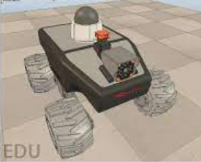
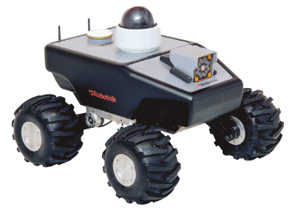
Search Problem
In practice, the representation of the mobile robot and its interaction with the physical and virtual environment cannot follow the planned path to the position target due to existing nonlinearities.
VIRTUAL
REAL

Slide 6
Nonlinearities
Controllers
Simulators
Friction
Inertial mass
Atmospheric pressure
Vibrations
Among others...
VIRTUAL
REAL

Slide 7
State-of-The-Art
Liang et al. (2020)
- Mathematical model of precision for virtual environment;
The Twinning process is at an initial state from the perspective of software solutions.
Kuts et al. (2020)
- Control of algorithm subtracting differences;
Müller et al. (2022)
- Genetic algorithm;
Liu et al. (2022)
- Reinforcement learning.

Slide 8
Scientific Method
Abductive reasoning consists of 3 steps as follows:
Searching for elements which although different have the same characteristics when treated with the same method,
Evaluating sets of data limited to infer the hypothesis,
Experiment to confirm the hypothesis.

Slide 9
The Log Mean Kinematics Difference Synchronization Method (SyncLMKD)
It arose from the analysis of likelihoods found between the problems and the solutions which The Log Mean Temperature Difference – LMTD solves related to the heat transfer. And applying the abductive reasoning scientific method it was possible to generalize the problem to apply it to the domain of mobile robot. For that, it turned out that The SyncLMKD Method is suitable for solving problems of distributed kinematic variations and in special for solving problems of twinning between the Digital Twin counterparts.

Slide 10



Numerical Modeling
Original equation used in heat exchangers.
Modeling equation for CPU cooling.
SyncLMKD equation linearly expressed for the distributed kinematic variations problem.

Slide 11
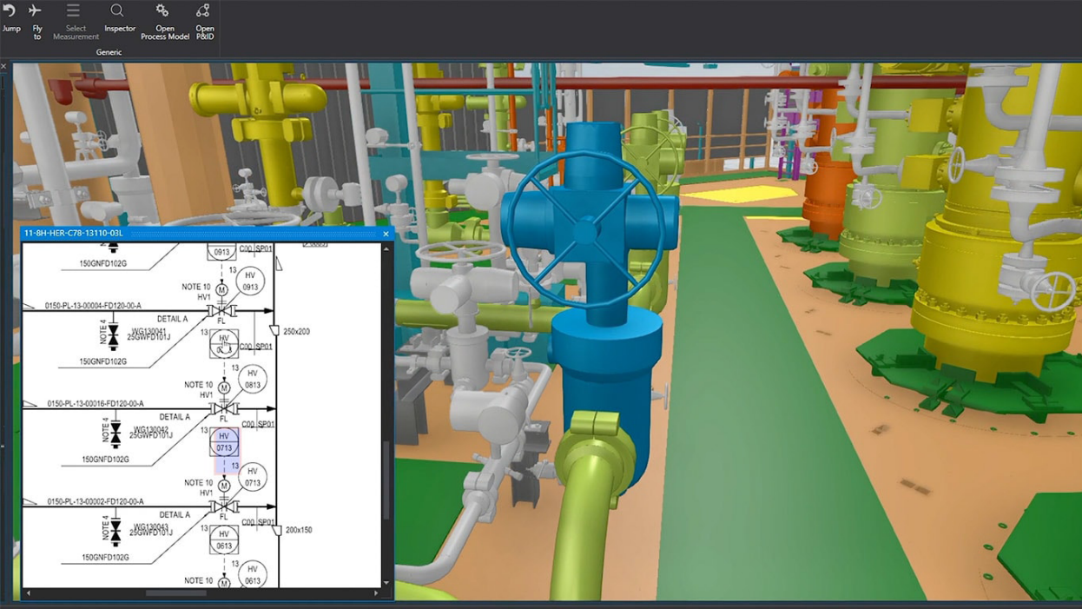

Digital Twin Purchased Environment
VALUES IN 2025
US$ 2.200/year for license, pre-paid annually;
or US$ 200/month for license, paid monthly.
Copyright Kongsberg Digital 2019

Slide 12
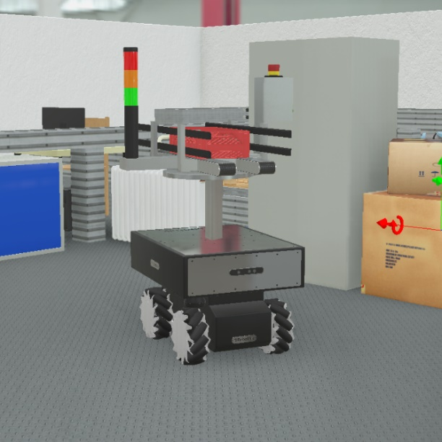
Educational Environment for The Digital Twin
Robotnik summit xl
REAL
Webot
VIRTUAL
Copelliasim
VIRTUAL
If the CoppeliaSim and the Webot simulators are connected to a controller even so there are variations between models.

Slide 13
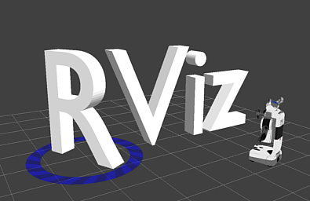
Open Environment for the Digital Twin
RViz is a 3D visualization platform of ROS (Robot Operating System). It has an open code as well as ROS for the customization of scenarios and robots.

Slide 14

Open solution
Open solutions allow the customization. In the state of the art were not found practical and didactic examples which could integrate the Mixed Reality - MR - with the Digital Twin - DT.

Slide 15
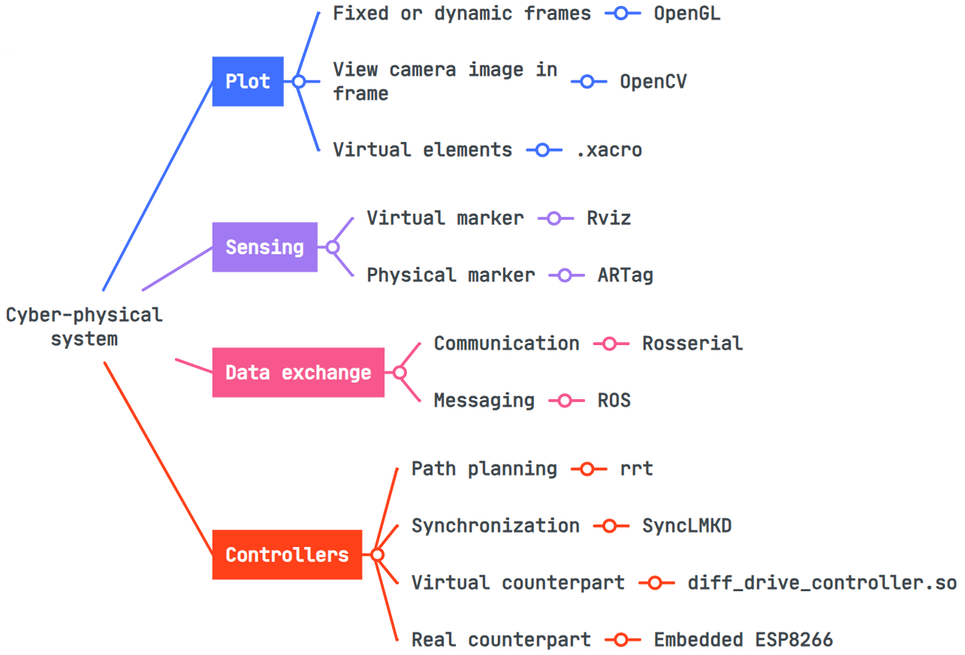
Developed Architecture

Slide 16
Technical Aspects
An .rviz configuration file contains an objects tree which are plotted in the setting, that way, the .launch file should align with the tree.
Coordinates x and y and the orientation should have a correspondence among all elements of the MR-DT or else the controller will erroneously link the movement.
The virtual and the real cam should be posed at the same distance and the orientation to be correctly calibrated.

Slide 17
Constraints
In MR environments it is possible to make physical elements to interact with virtual ones setting inclusive the same location at the same time nonetheless dynamic virtual elements cannot occupy the same location of the other dynamic virtual at the same time, as it also happens to the physical elements in the real world.
The implementation of the embedded controller of the physical robot is different from the implementation of the virtual one.

Slide 18
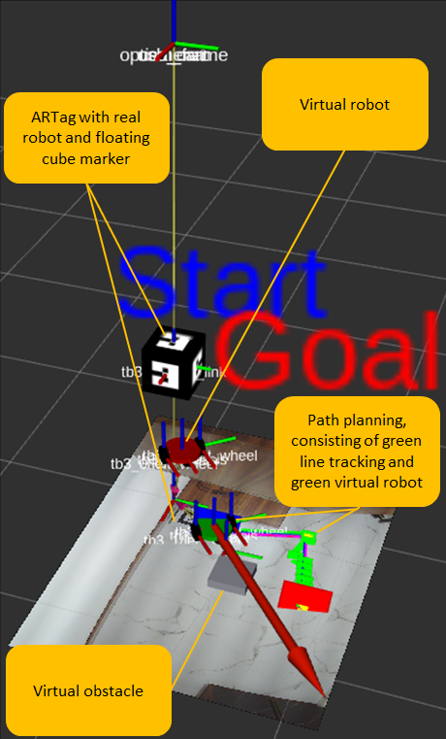
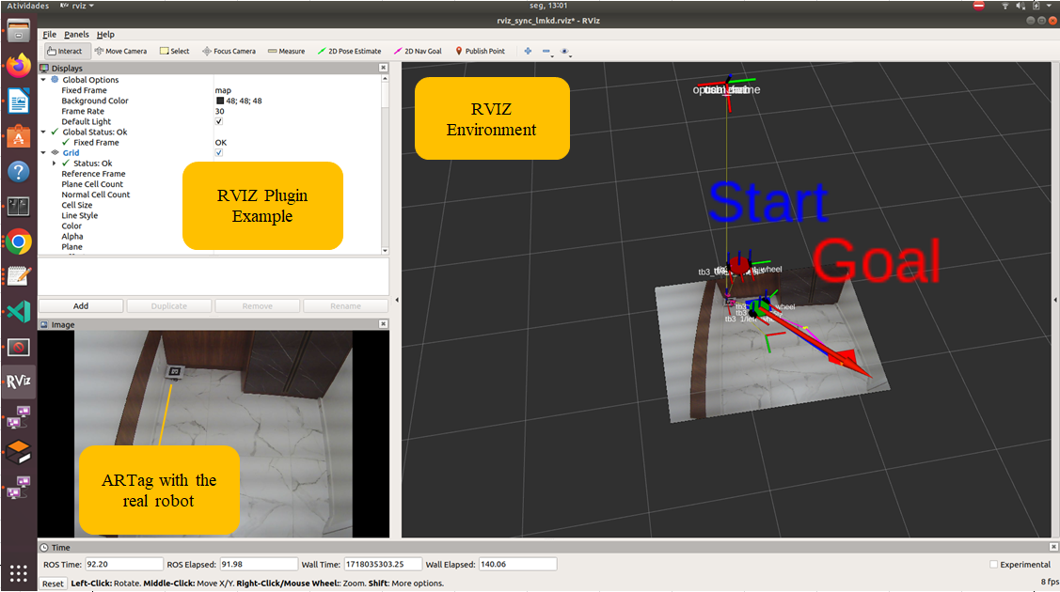
Results

Slide 19
Conclusion
MR environment needs to blend and detect both virtual and real elements. Our work met that requirement and used open technology for that implementation. The Digital Twin integrated to the MR had got virtual and real elements moving decoupled from one and other and the SyncLMKD was used for the synchronization between the Digital Twin entities.

Slide 20
Questions and Cooperation
For further information or even more questions about the presentation, also for cooperation, please contact:
fabiano.cardoso@ifpr.edu.br
fabiano.stingelins@gmail.com

